Slide 1
Pushdown Automata
PDAs
Lecture 7
Rowaida AL-Amri

Slide 2
Syllabus
1. Introduction to pushdown automata(PDA)
2. Difference between pushdown automata and finite state machine
3. Stack in pushdown automata
4. Push and pop operations in stack
5. Components of pushdown automata.

Slide 3
Introduction
What is a Pushdown Automaton?
A PDA : is a mathematical model of computation similar to a finite automaton, but it also has a stack.
Pushdown Automaton: is a way to implement a context free grammar in a similar way we design finite automata for regular grammar
- it is more powerful than FA
- FA has a very limited memory but PDA has more memory
- PDA = FA+A Stack

Slide 4
Introduction
A stack is a way we arrange elements one on top of another
A stack : is used to store an unlimited number of symbols. Consequently, a PDA can handle languages that require a stack, specifically Context-Free Languages (CFLs)
A stack does two basic operation
- PUSH : a new element is added at the top of the stack
- POP: the top element of the stack is read and removed
No Operation: No changes were made to the stack.
Top
C
b
a
stack

Slide 5
What is a stack?
A stack is a data structure that operates according to the principle :
LIFO — Last In, First Out
That is : The last element to be added is the first element to be remove
There are two basic operations in Stack.
1- Push: Add a token to the stack.
2- pop: Remove the token at the top of the stack.
Exp: If we push: A,B,C then: Stack = ABC and
the top element is: C
During a Pop operation, the following will be removed: C first.

Slide 6
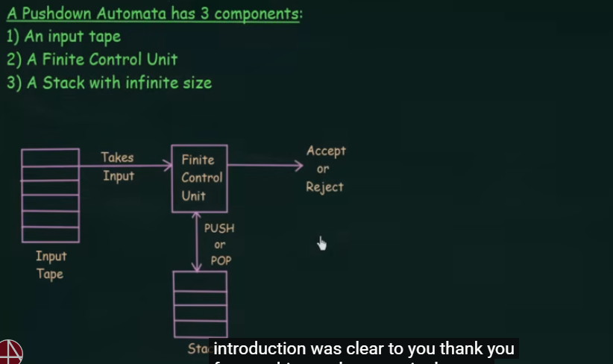
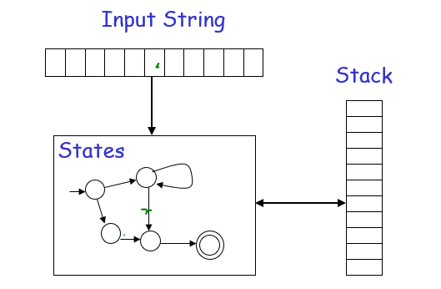
Pushdown Automaton has three component
1- an input tape
2- a finite control unit
3- a stack with infinite size

Slide 7
Components of a PDA
A PDA is mathematically defined using seven elements:
M=(Q,Σ,Γ,δ,q0​,Z0​,F)
Q: Set of States
Σ:Input Alphabet
Γ: Stack Alphabet
δ: Transition Function Symbol
q0​: Initial State
Z0: Initial Stack
F: Set of Acceptance States

Slide 8
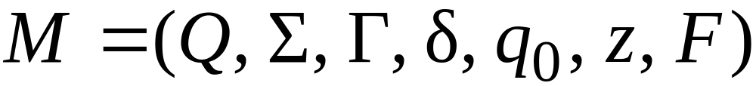
Formal Definition
Pushdown Automaton (PDA)
Final
states
States
Input
alphabet
Stack
start
symbol
Transition
function
Initial
state
Stack
alphabet

Slide 9
Difference Between an FA and a PDA
In a DFA, the transition depends on:
Current State + Input
Whereas in a PDA:
Current State + Input + Stack Top
This is the main reason for the PDA’s power compared to DFAs and NFAs.

Slide 10
Types of PDAs
There are two main types:
1. Deterministic PDA (DPDA)
For every state, there is a single, well-defined transition.
2. Non-Deterministic PDA (NPDA)
There may be more than one possible transition from the same state.
The NPDA is more powerful than the DPDA in recognizing certain context-free languages.

Slide 11
Why do we need a PDA?
Example :
L={a^{n} b^{n} ∣ n≥1}
Such as (aaabbb)
We need to make sure that the number of a's equals the number of b’s.
A DFA cannot keep track of the number of a's it has read.
But a PDA can :
While reading an a , It places each a on the stack.

Slide 12
Transition in a PDA
A PDA transition can be represented as follows:
δ(q,a,X)=(p,γ)
This means: If the machine is in state q, reads the symbol a, and the top of the stack is X, then transition to state p and replace X with the string gamma.
Exp: δ(q0​,a,Z0​)=(q0​,AZ0​) Z0​→AZ0​
Current state: q0
We read: a
Top of the stack: Z0
We move to q0
and push A onto Z0

Slide 13
Transition in a PDA
A PDA transition can be represented as follows:
δ(q,a,X)=(p,γ)
- q is a stste in Q
- a is either an input symbol in Σ or a=empety
- X is a stake symbol that is a member of Γ
the output of δ is finite set of pairs (p,γ) where :
- p is s new state
- γ is a straing of saack symbols that replaces X at the top of the stack
If γ = ɛ then the sack is popped
If γ = X then the sack is unchanged
If γ = yZ then X is repllacced by Z and y is push onto the stack

Slide 14
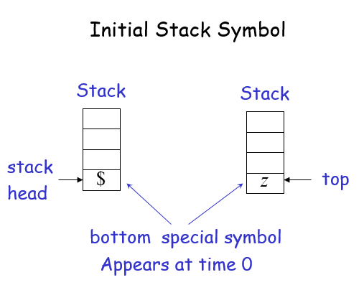

Slide 15
Graphical notation
Finite atomata
Pushdown Automata
A
a
B
A
a , b c
B
Symbol an top of the stack this symbol is popped
This symbol is pushed onto the stack
Input symbol
‘ɛ’ means nothing is pushed
Maybe ɛ
‘ɛ’ means the stack is neither read no popped

Slide 16
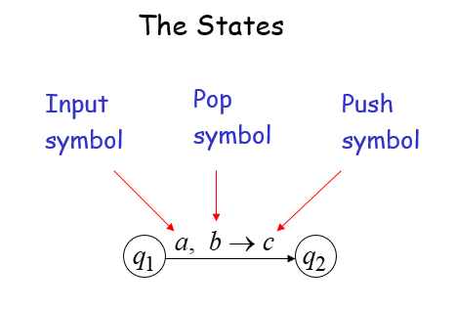

Slide 17
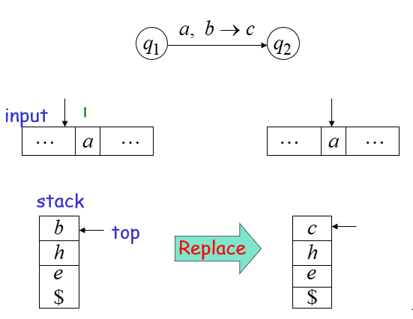

Slide 18
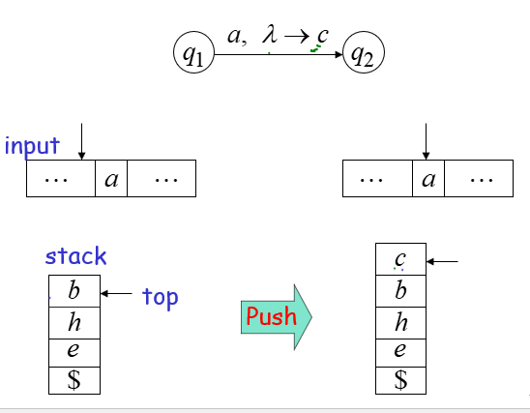

Slide 19
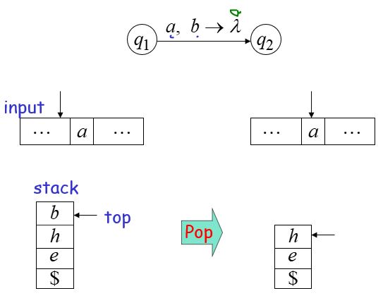

Slide 20
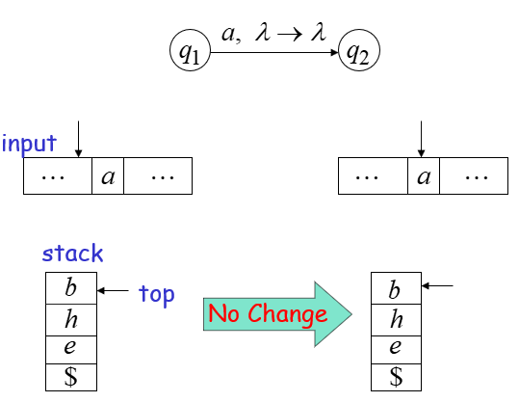

Slide 21
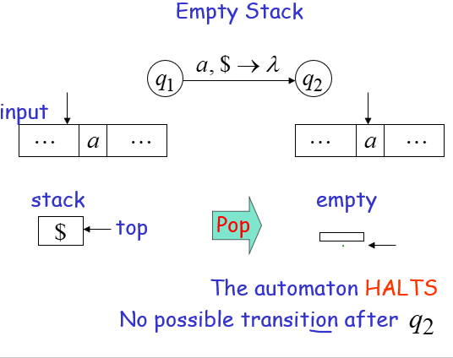

Slide 22
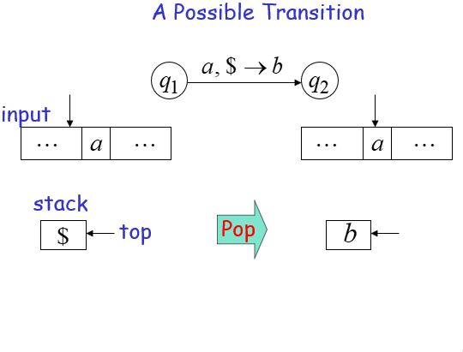

Slide 23
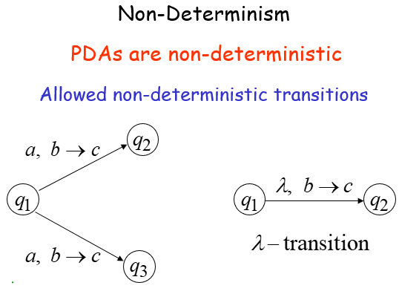

Slide 24
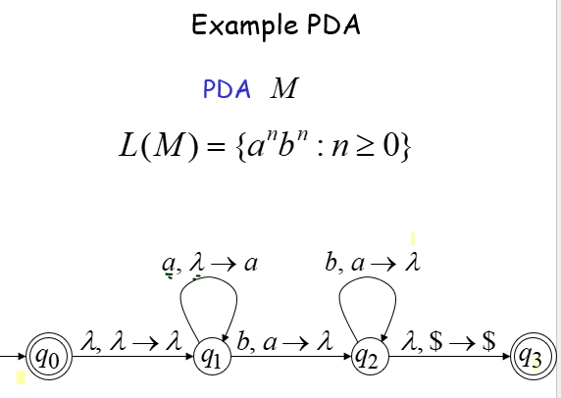

Slide 25
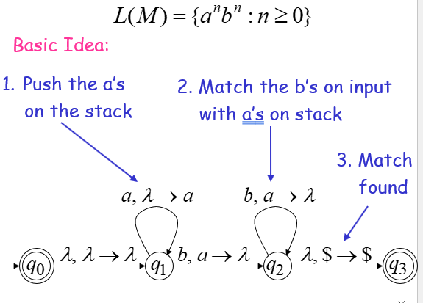

Slide 26







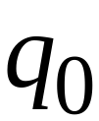



Execution Example:
Time 0
Input
Stack
current
state

Slide 27
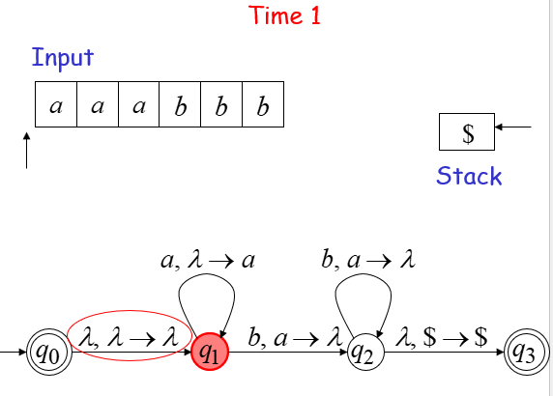

Slide 28
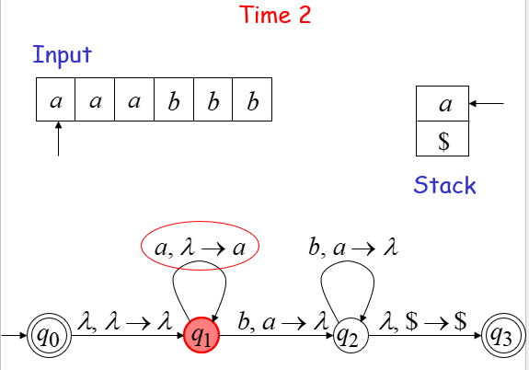

Slide 29
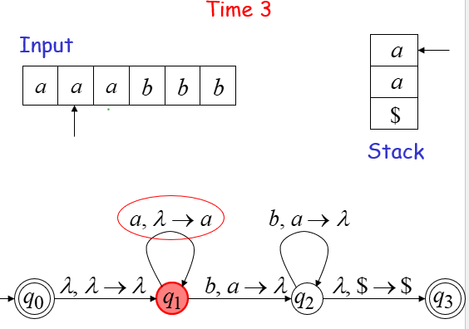

Slide 30
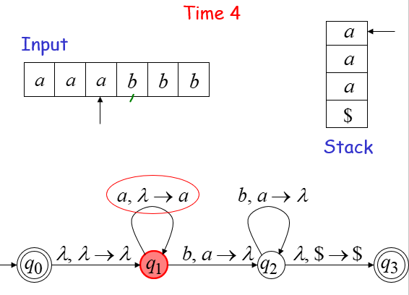

Slide 31
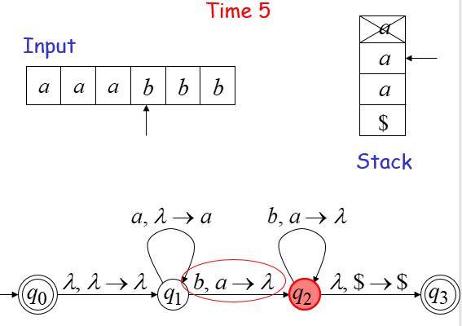

Slide 32
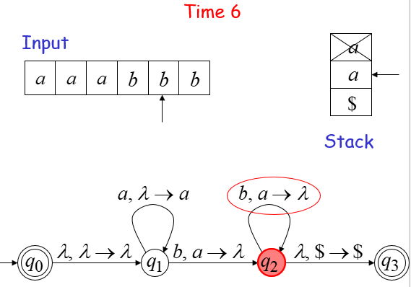

Slide 33
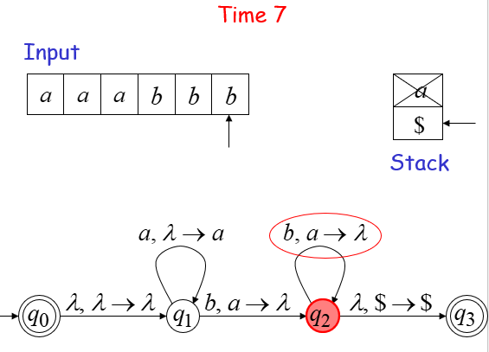

Slide 34
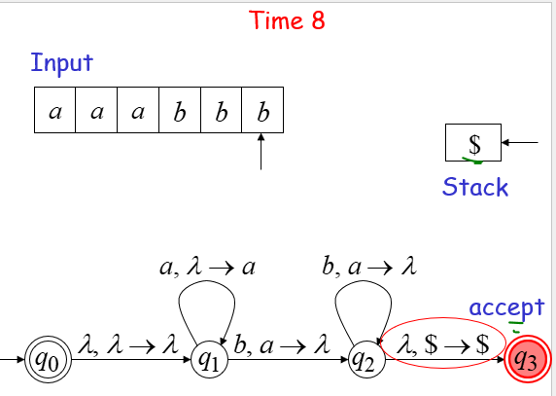

Slide 35
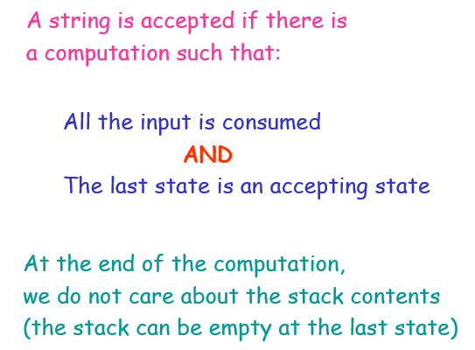

Slide 36
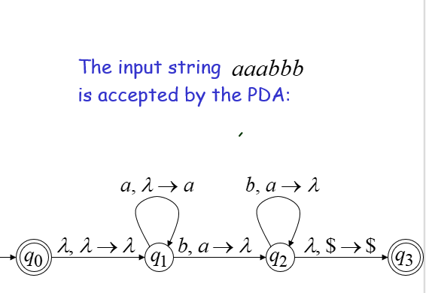

Slide 37
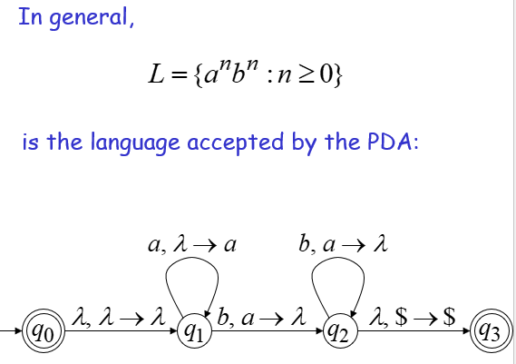

Slide 38
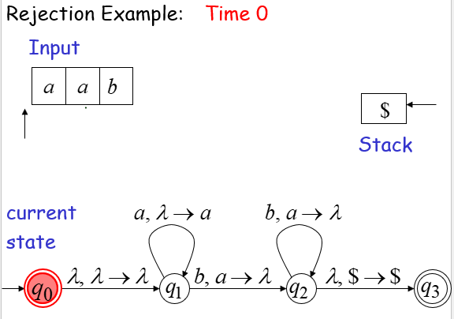

Slide 39
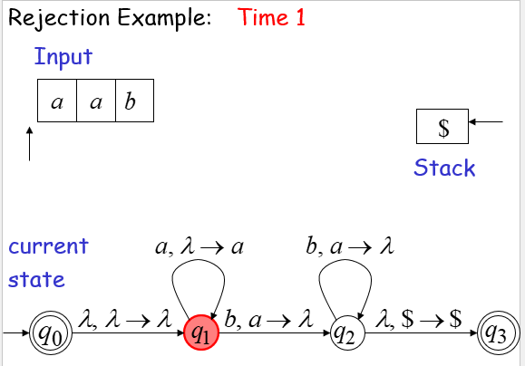

Slide 40
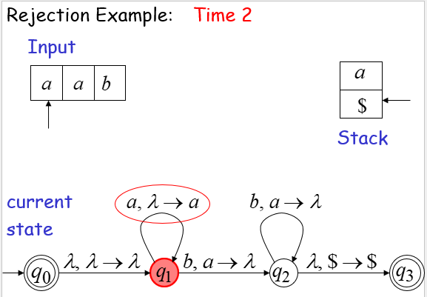

Slide 41
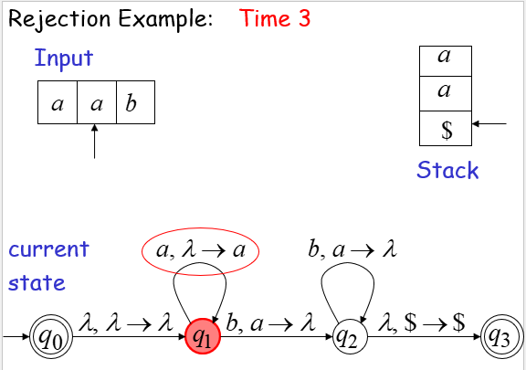

Slide 42
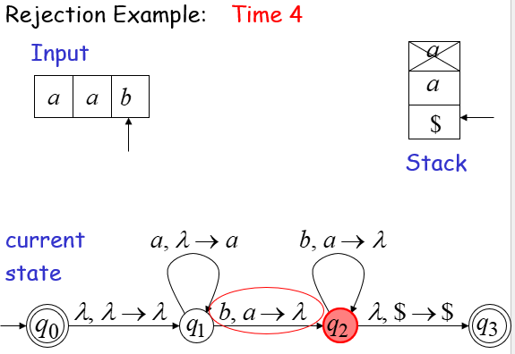

Slide 43
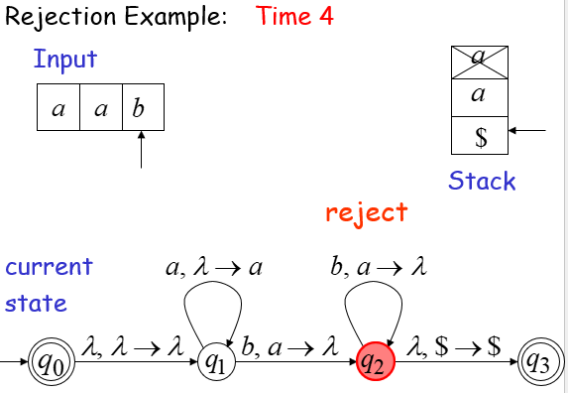

Slide 44
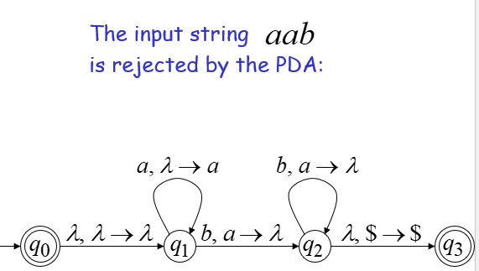

Slide 45
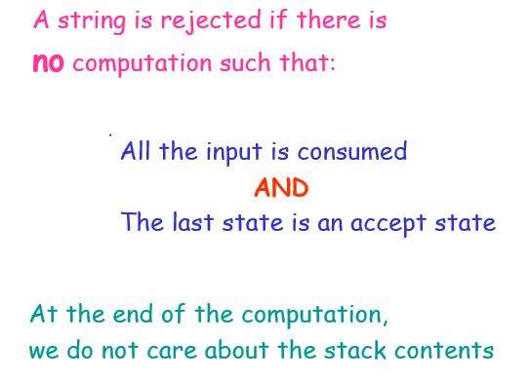

Slide 46
The Relationship Between FA, PDA, and the Turing Machine
Finite Automata --- Pushdown Automata--- Turing Machine
Finite Automata They have very limited memory.
Learn about: Regular Languages
PDA :Stack Learn about :Context−Free Languages
Turing Machine : It has a more general-purpose memory and handles a much wider range of languages.

